Slide 1
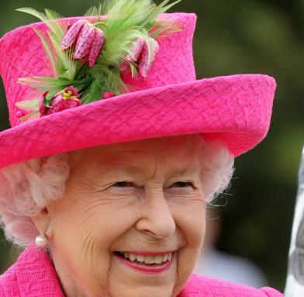
Prezentacja o królowej Elżbiecie II
Autor: Mateusz Niski klasa: 8A

Slide 2
Przejęcie tronu przez Elżbiete
His father's illness – he was diagnosed with throat cancer – caused Princess Elizabeth to take over some of his duties. In 1951 she visited Greece, Italy, Malta and Canada, and met with American President Harry Truman in Washington, and chaired the Deliberations of the Privy Council. In January 1952, she and her husband traveled to the Commonwealth countries. On 6 February 1952, while staying at the Treetops Hotel in Thice, Kenya, she learned of the death of her father, who had died of a heart attack, from Prince Philip. She immediately returned to the UK with her husband. Shortly after her father's death, in a conversation with Martin Charteris, assistant to her private secretary, she announced the choice of the royal name – Elizabeth. The day after her father's death, she was proclaimed Queen of great Britain. The ceremony, which took place at St. James's Palace, was attended by m.in members of the Privy Council of Great Britain and Lord Mayor of London.

Slide 3
Dzieci królowej
With Philip she had four descendants, they are:
Charles III (born 14 November 1948), King of Great Britain
Anna (born 15 August 1950), Princess
Andrew (born 19 February 1960), Duke of York
Edward (born 10 March 1964), Earl of Wessex

Slide 4
Miłość królowej do psów rasy corgi
Elizabeth II loved animals, especially cute dogs with short legs. The corgi cardigan breed accompanied her throughout her life. The first puppy - Susan, received for her 18th birthday from her father. From that moment until her death, she could have had as many as 30 of them.

Slide 5
Młodość królowej
The Queen was born by caesarean section on 21 April 1926 at 2:40 GMT at a house at 17 Bruton Street in the Mayfair district of London. She was the daughter of Prince Albert of York, the second son of the incumbent King George V, and the Duchess of York, Elizabeth Bowes-Lyon.

Slide 6
Odpowiedniki Królowej Elżbiety II w filmach i serialach
Elizabeth II has been shown many times in cinema and television, both in serious films and comedies: -Jeanette Charles has played the Queen many times since 1975 -Dana Wynter in The Royal Romance of Charles and Diana (1982) -Prunella Scales in A Question of Attribution from 1991 -Elizabeth Richard has played the Queen many times since 1996 -Oscar role of Helen Mirren in The Queen (2006) -Scott Thompson in The Children in the Hall -Irene Hamilton in the 2003 film Johnny English -Elizabeth Richard in the 2012 film -Freya Wilson in the 2010 film How to Become a King -Sarah Gadon in the 2015 film "A Date with the Queen" -Claire Foy and Olivia Colman in The Crown (2016)

Slide 7
śmierć
On the morning of 8 September 2022, Buckingham Palace reported that doctors were concerned about Elizabeth's health. The Queen was then at the residence in Balmoral. The seriousness of the situation was also indicated by the fact that the Queen's immediate family abandoned their activities from that day and went to her place of residence. The British Queen died at 3:10 p.m., British time, surrounded by her family at Balmoral Castle.

