Slide 1
TRADITIONAL WRITTEN COMMUNICATION
LETTERS
MEMOS
PROPOSALS

Slide 2
lETTERS
PARTS OF EFFECTIVE LETTERS
DIFFERENST TYPES OF LETTER FORMATS
COMPOSING AN EFFECTIVE LETTER

Slide 3
Introduction
a letter – one of the most formal documents you can send, therefore it conveys a high degree of respect to its recipient
letters are ususally one- to two- page documents sent to people or organizations outside the organization from which they´re sent
memos are documents for communications within an organization
although we use email for many of the occasions that we used to send letters for before the twenty-first century, letters are still sent rather than emails for several purposes: (see next slide)

Slide 4
Cover letters to employers in job applications
Thank-you letters and other goodwill expressions
Letters of recommendation (a.k.a. reference letters)
Letters of transmittal to introduce reports or proposals
Official announcements of products, services, and promotions to customers
Claims and other complaints sent to companies to lay down a formal paper-trail record as evidence in case matters escalate into the court system
Formal rejection notices to job or program applicants
Collection notices to people with overdue payment
In these cases, letters offer the advantage of formality, confidentiality (it’s illegal to open someone else’s mail), and a record of evidence.

Slide 5
Types of Letter Formats
two main types of letters:
block-style letters
modified-block style
The block-style used by organizations has a company letterhead at the top, whereas modified-block letters are typically written independently by individuals.

Slide 6
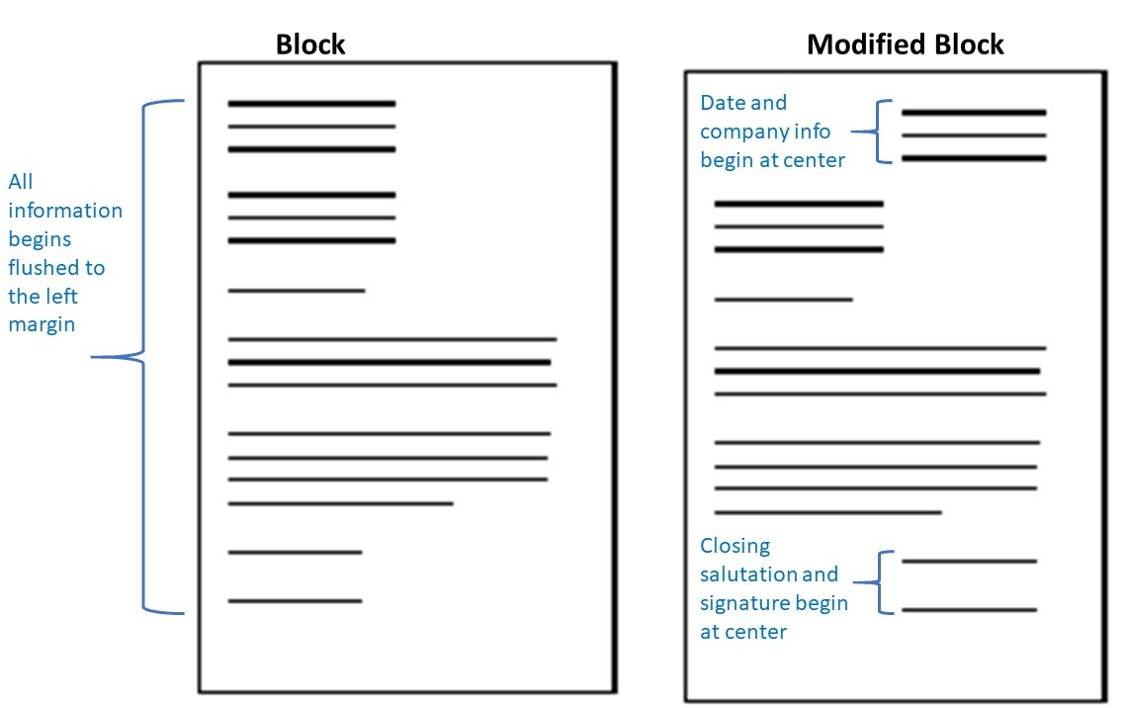

Slide 7
Letter Parts
letter have 10-12 parts, inculding:
Return address or company letterhead
Date line
Recipient addresss
subject reference
opening salutation
message opening
message body
message closing
closing salutation
signature
signature block
enclosure notice

Slide 8
The following video explains each part of a standard letter:
Writing a Formal business letter
https://youtu.be/7xUTguLaaXI

Slide 9
SOURCES:
https://kpu.pressbooks.pub/communicationsatwork/part/chapter-7-traditional-written-communication/

