Slide 1
WORK INTERSHIPS IN GREECE
Erasmus+

Slide 2
SUMMARY
Trip to Meteors
Trip to Litochoro
Free time
Interships

Slide 3
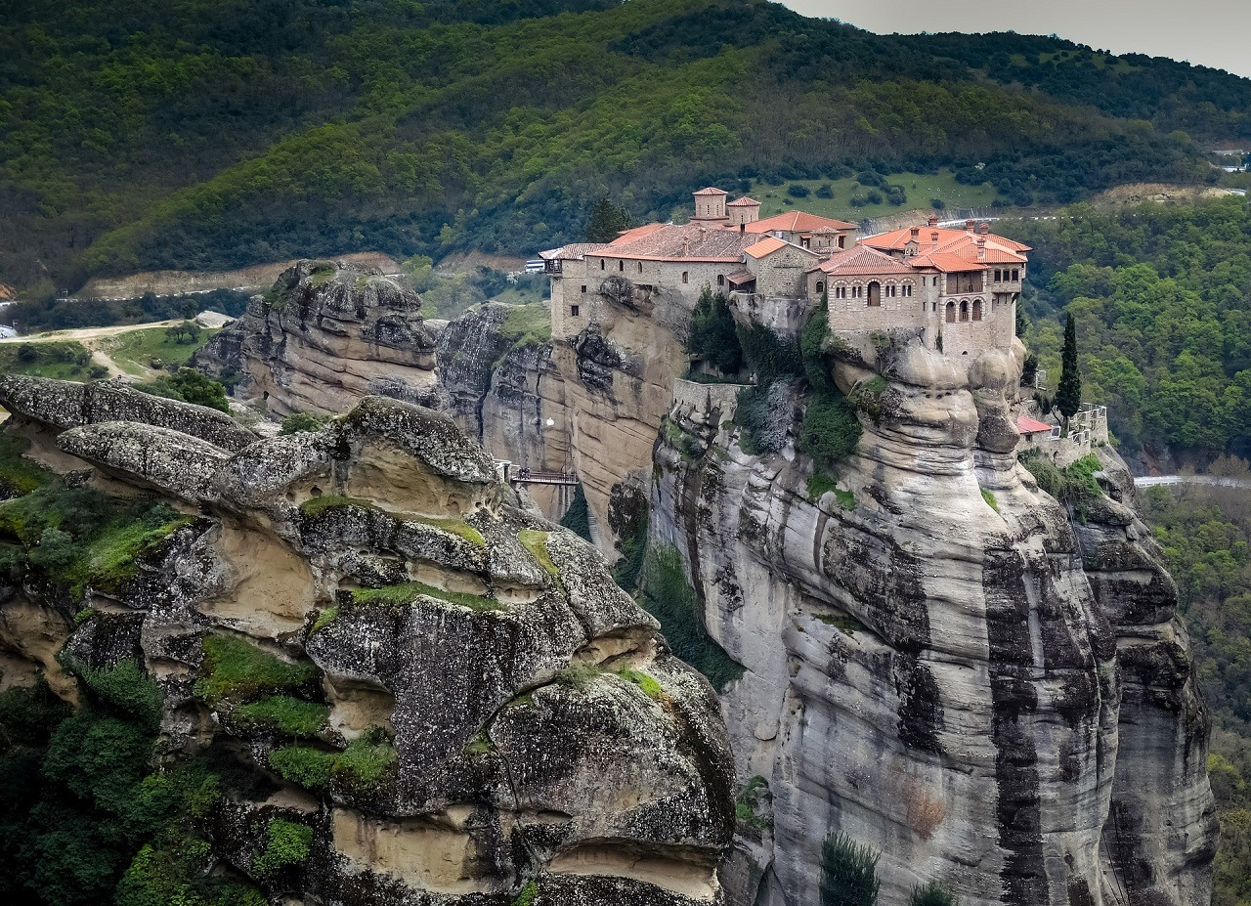
Trip to Meteors
We visited one of the monasteries located on Meteors, a rock massif of sandstone and conglomerate, located near the city of Kalambaka, in the Thessalian plain in central Greece, at an altitude of up to 540 meters above sea level.
spis

Slide 4
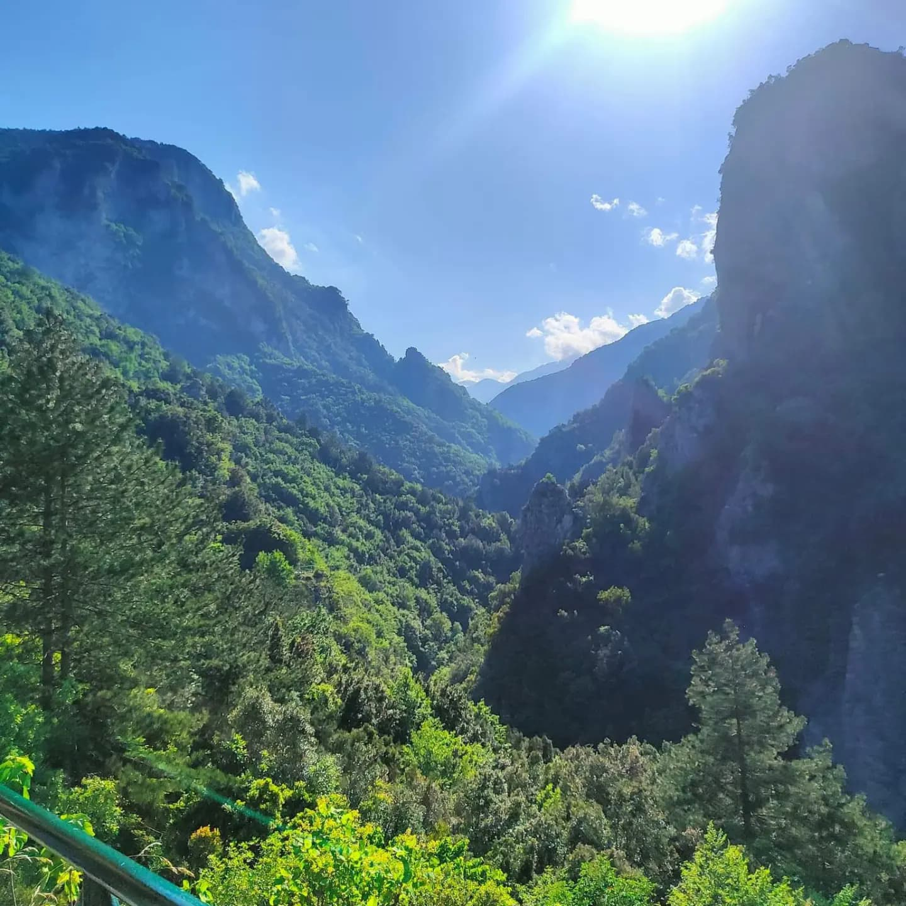
Trip to Litochoro
In Litochoro, we saw a beautiful landscape by walking along a special path to reach the main part, the waterfall. After descending to the town, we had the opportunity to buy herbs and taste the local tea.
spis

Slide 5
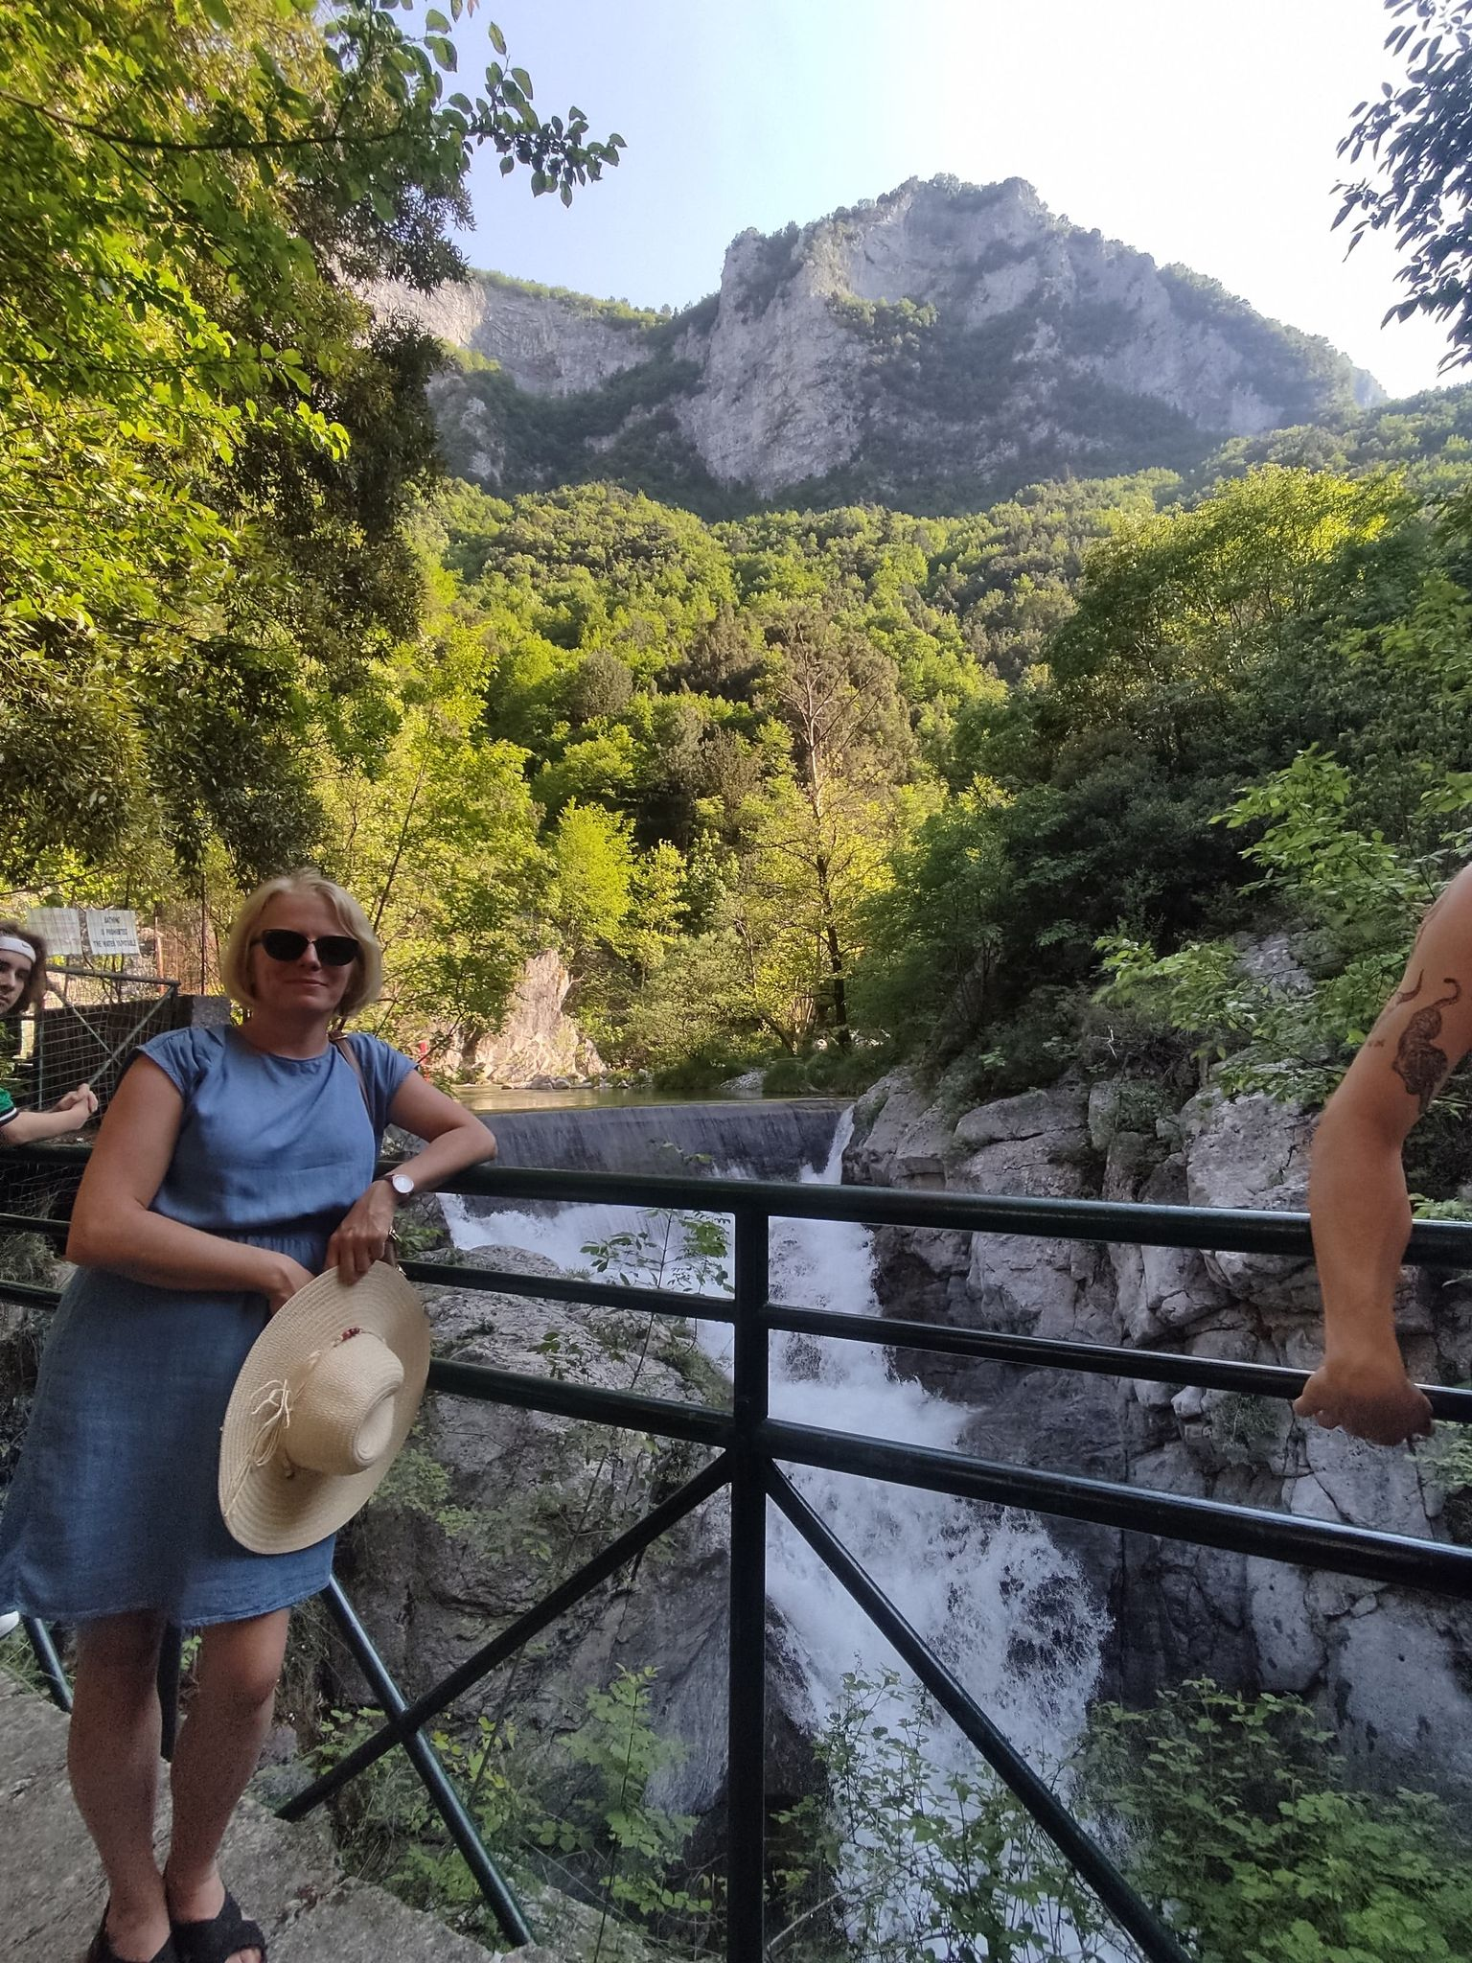
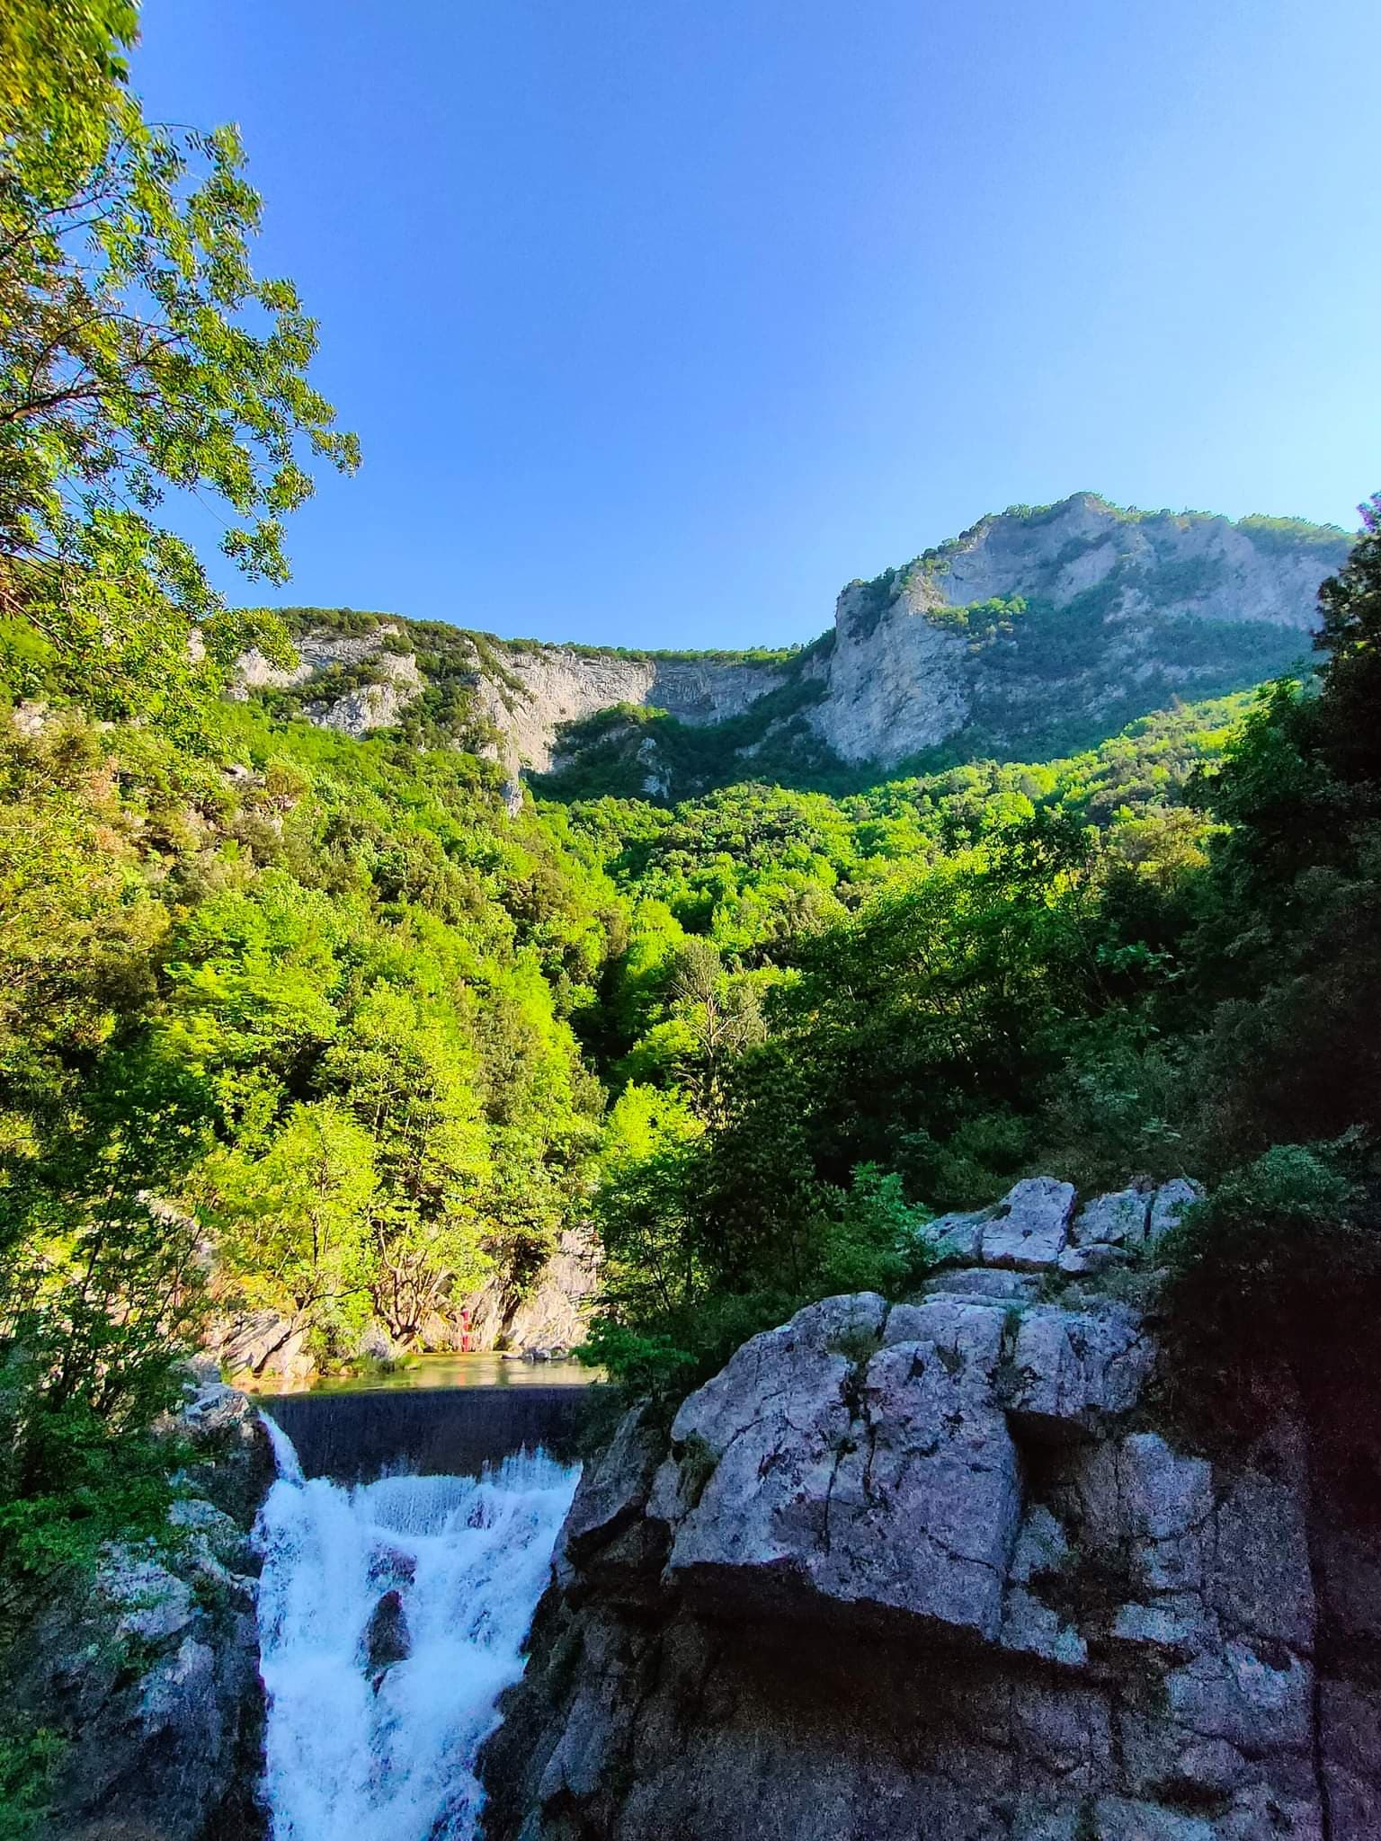
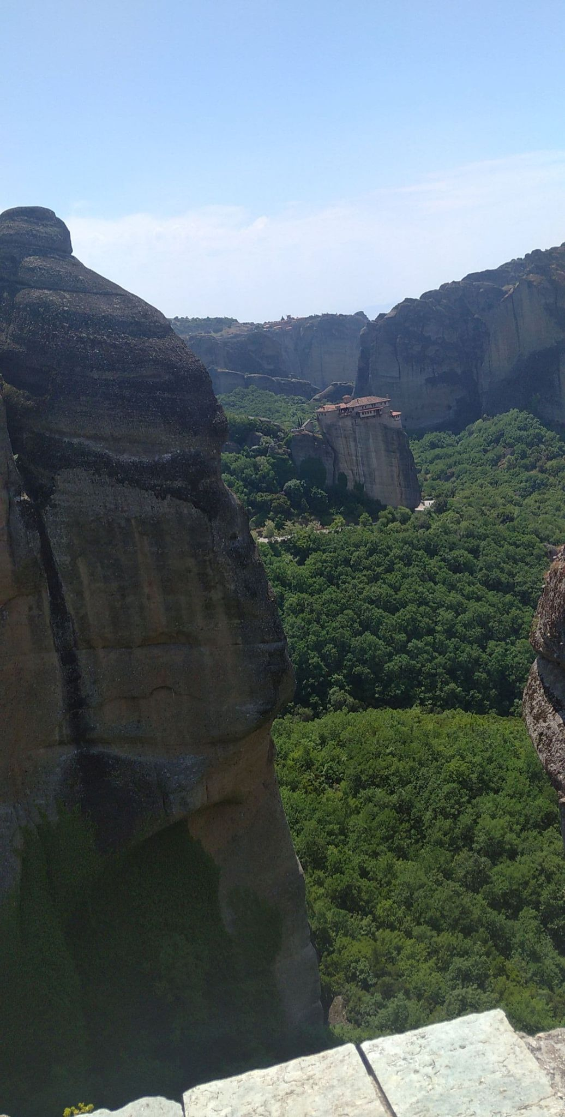
.
.
spis

Slide 6
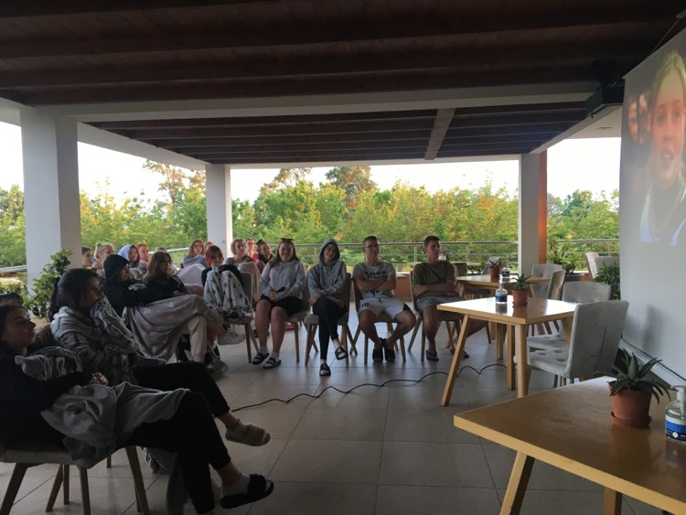
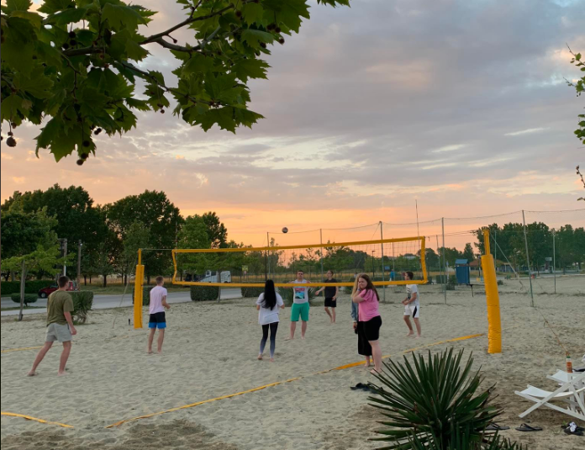
Free Time
In our free time, we could integrate with the group that we came. Watch a movie together or spend a moment together playing volleyball or sunbathing together.
spis

Slide 7
Interships
One of the main goals of our trip was apprenticeship for work practise. These internships were in Paralia and Katerini. There was a school in Paralia to which we commuted by bus. We learned the basics of robot programming there, while having a great time with the LEGO Mindstorms robots. We learned how to program a device in the arduino program. We also got acquainted with the health and safety rules of our practices.
spis

Slide 8
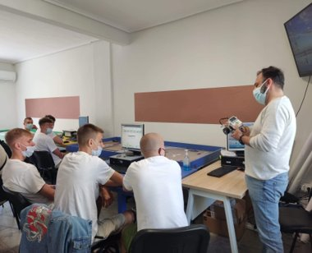
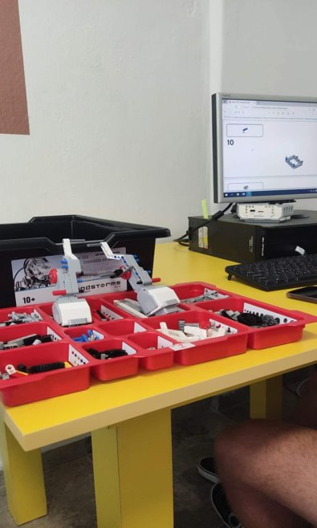
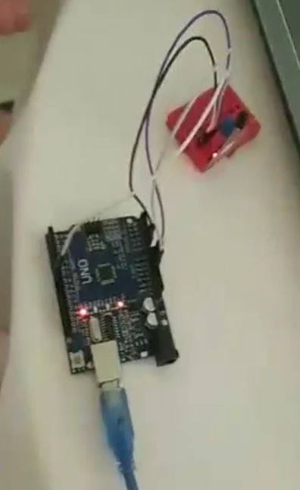
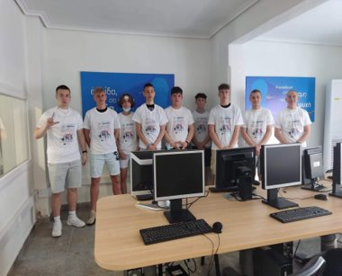
.
.
spis

Slide 9
Thank you for your attention
Made by:
Filip Trzciński
Sebastian Baranowski
Maks Malecki

