Slide 1
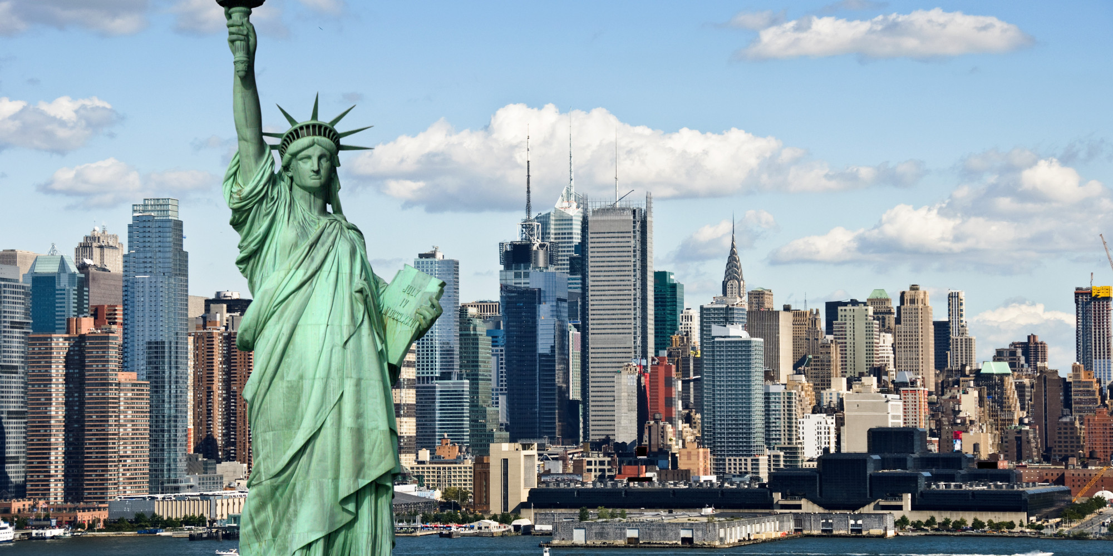
NEW YORK

Slide 2
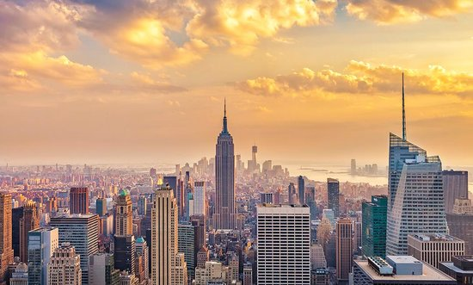
FACTS ABOUT NEW YORK
Known as The Big Apple
The city that never sleeps
The Empire city
Has got 5 big parts
Home of the tall`s buildings in the world

Slide 3
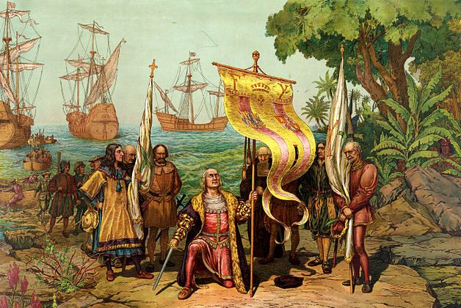
History
home of Delaware Indians 400 years ago
discovered by Italian explorer Giovannidi Verrazzano in 1524
the Dutch established New Amsterdam in 17th century
it started to be setttled by Europeans – Germany, Ireland, Italy, Poland, Chine..

Slide 4
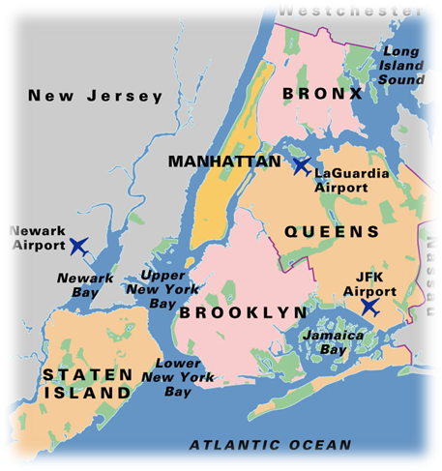
New York city has got 5 large boroughs:
Bronx
Manhattan
Brooklyn
Staten Island
Queens

Slide 5
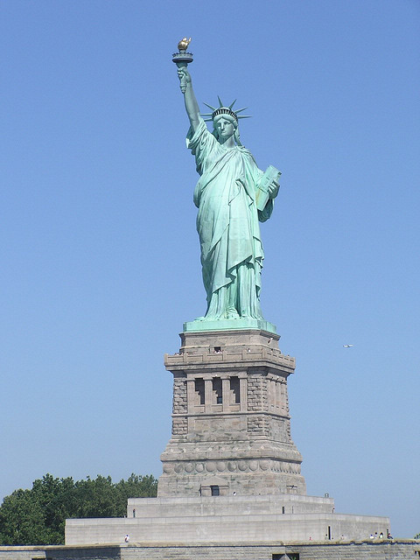
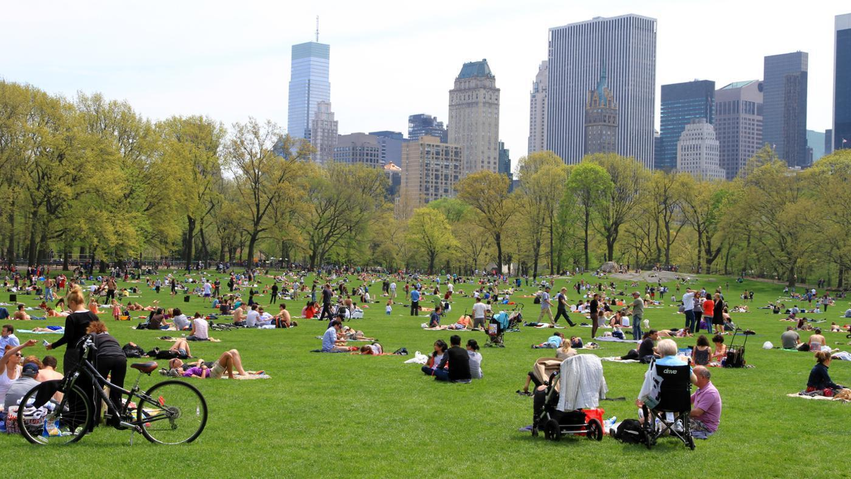
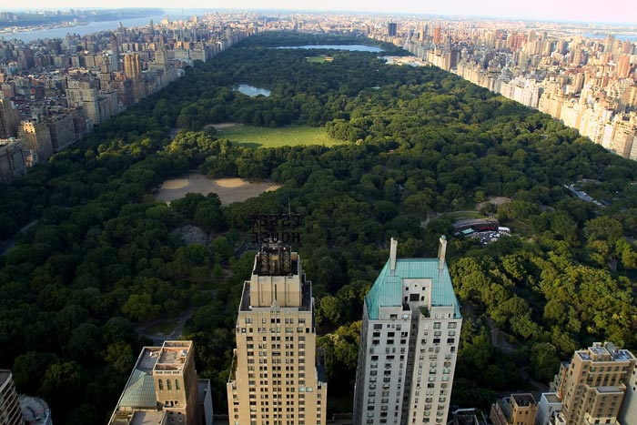
Famous places in New York
Statue of Liberty
Central park

Slide 6
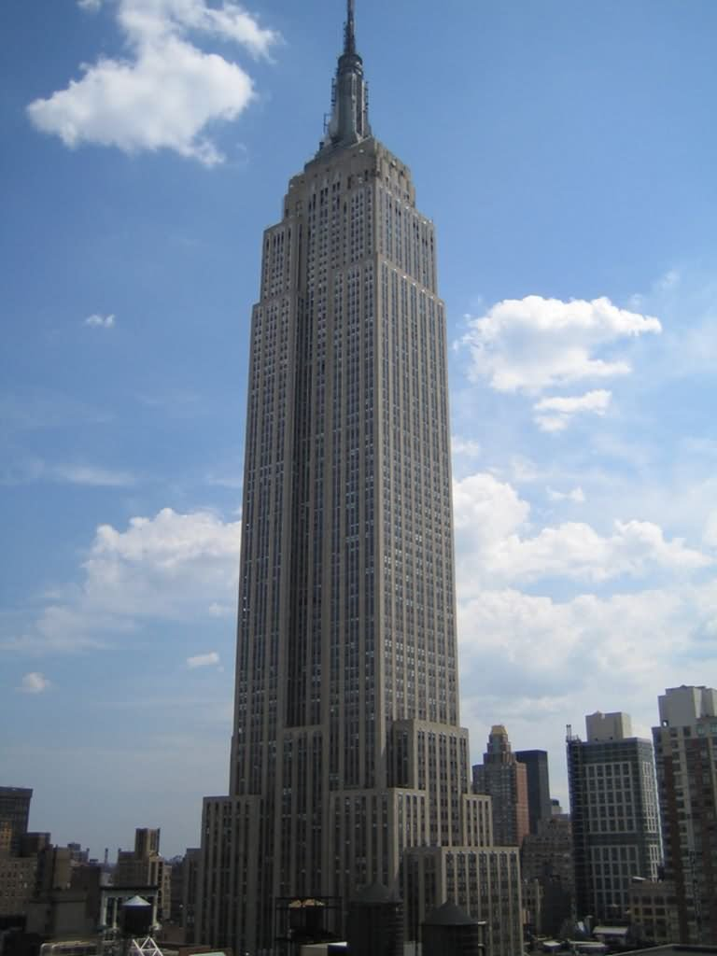
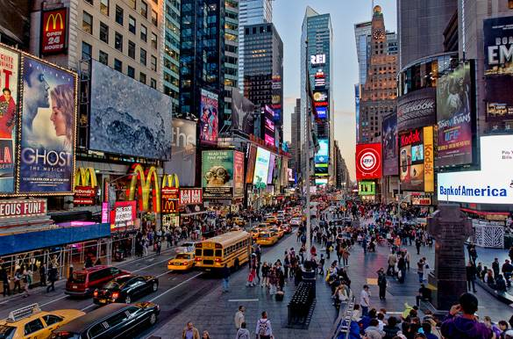
The Empire State Building
Time square

Slide 7
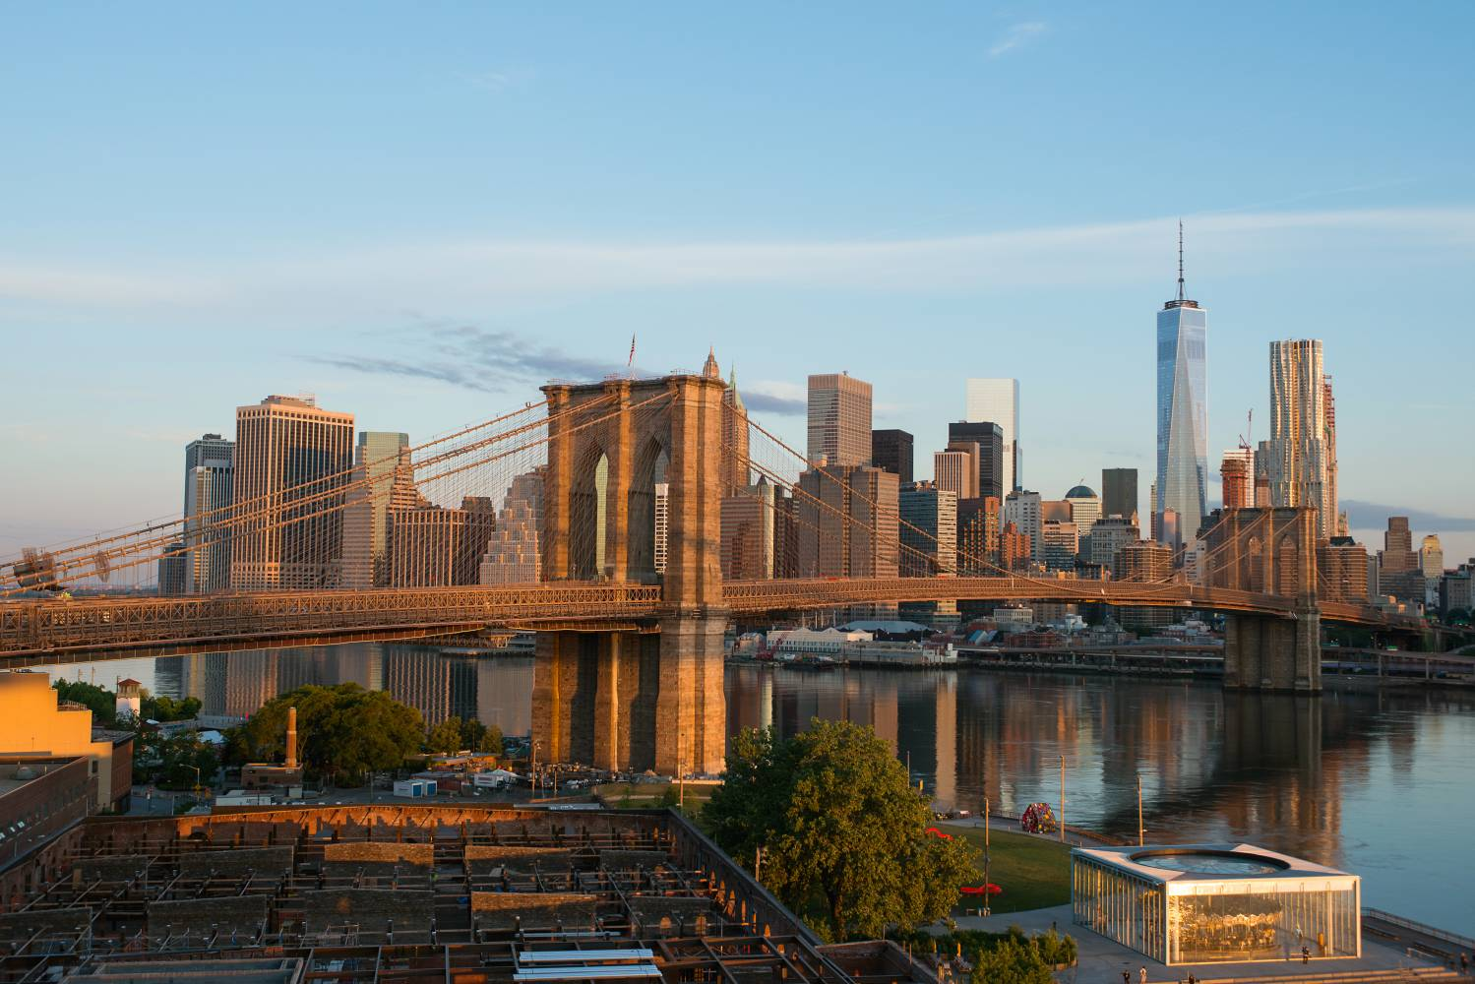
Brooklyn bridge

Slide 8
AMERICAN MUSEUM OF NATURAL HISTORY

Slide 9
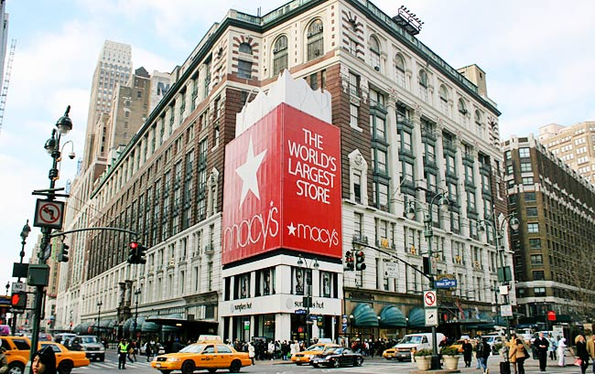
The biggest shop Macy' s

Slide 10
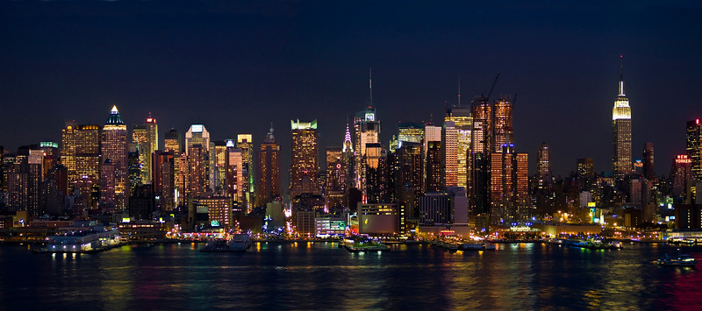
Thank you for your attention
by Iveta Domianova

